Slide 1


Better by your side.
THIS IS LYNX.
Prepared for: [Client Name]
JUDr. Margareta Sovova • Rechtsanwältin • Managing Partner International
INTRO • • • • • • •

Slide 2

Who we are
LYNX is an international business law firm committed to helping companies make better decisions, reduce risk, and accelerate progress. We don’t position ourselves as external advisors, but work side‑by‑side with your team – close, proactive, and deeply invested in your success.
Operating across all major Central and Eastern European markets, we deliver consistent, commercially-focused guidance that keeps your strategy moving forward – across borders and beyond expectations.
POLAND • SLOVAKIA • ROMANIA
LATVIA • CZECH REPUBLIC • ESTONIA
HUNGARY • LITHUANIA • BULGARIA
• FIRM • • • • • •

Slide 3

13
22
25+
Offices across CEE
Working languages
Years of experience
60+
200+
Partners
Lawyers
• FIRM • • • • • •

Slide 4
We don’t just advise
– we commit.
• • VALUES • • • • •

Slide 5

Why
What
How
We fight to unlock the
maximum potential for our
clients, turning legal
challenges into strategic
advantages.
We deliver outstanding legal services to global enterprises and high-performing mid-sized companies.
Not only to protect their rights, but to help them move ahead in their markets.
With personal dedication, fast response times, and a tightly connected team that thinks and acts like entrepreneurs.
• • VALUES • • • • •

Slide 6

By your side.
Acting like stakeholders.
We work as if we were part of your
organisation: alert, focused on your goals,
creating tailored solutions rather than standard templates.
We understand the impact legal decisions have on your business. We advise with the same clarity, pragmatism, and ownership we would expect as business owners ourselves.
First responders.
Giving you gold.
You receive immediate, proactive engagement.
We react quickly, raise critical issues early, and keep your matter moving without delay.
Our work is an investment in tangible value:
better negotiation outcomes, reduced risk, stronger structures, and early dispute resolution.
• • VALUES • • • • •

Slide 7

Nine markets.
One standard: yours.
• • • OFFICES • • • •

Slide 8

BULGARIA
With a team of 10 lawyers, LYNX Bulgaria has been serving the legal needs of businesses with a commercial commitment in Bulgaria and Southeast Europe since 2013.
Led by Stela Ivanova and Sebastian Harschneck, we advise international and domestic clients across all industry sectors, leveraging our cross-border expertise and diverse cultural insight to deliver comprehensive, business-focused legal solutions.
LYNX NEUPERT IVANOVA & KOLEGI
12 IVAYLO STR.,
SOFIA 1000
T +359 2 980 1117
BULGARIA@LYNX.LEGAL
• • • OFFICES • • • •

Slide 9
CZECH
REPUBLIC
With a team of attorneys in Prague, LYNX Czech Republic has been serving the legal needs of businesses with a commercial commitment in the Czech market since 2003.
Led by Tomáš Běhounek, Peter Maysenhölder, Jakub Kasl, Jiří Havlík, and Lenka Zachardová, we advise international and domestic clients across all industry sectors, combining deep expertise in real estate, M&A, employment law, and dispute resolution to deliver comprehensive, business-oriented legal solutions.
LYNX LEGAL S.R.O.
NA PŘÍKOPĚ 859/22
110 00 PRAGUE 1
T +420 222 929 301
CZECHIA@LYNX.LEGAL
• • • OFFICES • • • •

Slide 10
ESTONIA
With a team of 9 specialists, our Tallinn office has been serving the legal needs of businesses with a commercial commitment in Estonia since 2014.
Led by Tarvo Lindma and Karoliina Kõrgesaar, we advise international and domestic clients across all industry sectors, combining expertise in litigation, company law, contract disputes, media law, data protection, administrative law, and spatial planning to deliver comprehensive, practical legal solutions.
ADVOKAADIBÜROO SUPREMIA OÜ.
TELLISKIVI 60/1
10142 TALLINN
T +372 6 008 555
ESTONIA@LYNX.LEGAL
• • • OFFICES • • • •

Slide 11
HUNGARY
With a team of lawyers in Budapest, LYNX Hungary has been serving the legal needs of businesses with a commercial commitment in Hungary since 2003.
Led by Jan Burmeister, dr. Ratatics Éva,
dr. Norbert Varga, and Rainer Tom, we advise international and domestic clients across all industry sectors, combining local expertise with international insight in corporate M&A, employment, real estate, energy, IP, life sciences, and insolvency to deliver comprehensive, business-focused legal solutions.
LYNX LEGAL ÜGYVÉDI IRODA
STEFÁNIA ÚT 101- 103.,
H-1143 BUDAPEST
T +36 1 413 34 00
HUNGARY@LYNX.LEGAL
• • • OFFICES • • • •

Slide 12
LATVIA
With a team of lawyers in Riga, LYNX Latvia has been serving the legal needs of businesses with a commercial commitment in Latvia since 2004.
Led by Henning Jensen and Kārlis Sviķis, we advise international and domestic clients across all industry sectors, combining expertise in M&A, real estate, employment, litigation, insolvency, agricultural law, and cross-border inheritance to deliver comprehensive, business-focused legal solutions.
LYNX ZAB SIA
ANTONIJAS IELA 24 - 7
1010 RIGA
T +371 66 16 44 11
LATVIA@LYNX.LEGAL
• • • OFFICES • • • •

Slide 13
LITHUANIA
With a team of 10 lawyers in Vilnius, LYNX Lithuania has been serving the legal needs of businesses with a commercial commitment in Lithuania since 2004.
Led by Frank Heemann and Yvonne Goldammer, we advise international and domestic clients across all industry sectors, combining expertise in corporate and cross-border M&A, insolvency and restructuring, international contracts, employment, regulatory matters, and complex disputes to deliver comprehensive, business-focused legal solutions.
LYNX LEGAL APB
EMBASSY HOUSE, K. KALINAUSKO STR. 24-401
LT-03107 VILNIUS
T +370 5 212 16 27
LITHUANIA@LYNX.LEGAL
• • • OFFICES • • • •

Slide 14
POLAND
With a team of nearly 100 Experts across Warsaw, Gdańsk, Katowice, and Poznań, we have been serving the legal needs of businesses with a commercial commitment since 2001.
Led by Jarosław Sroka in Warsaw, Maciej Prusak in Gdańsk, Piotr Jurczak in Katowice, and Christoph Garschynski in Poznań, we advise international and domestic clients across all industry sectors, combining full-service expertise in public procurement, energy, dispute resolution, employment, real estate, TMT, banking, and M&A to deliver comprehensive, business-focused legal solutions.
LYNX BROCKHUIS & PARTNERS SP.K.
UL. TWARDA 18
00-105 WARSAW
T +48 22 279 31 00
POLAND@LYNX.LEGAL
• • • OFFICES • • • •

Slide 15
ROMANIA
With a team of nearly 30 lawyers across Bucharest and Timișoara, we have been serving the legal needs of businesses with a commercial commitment in Romania since 2000.
Led by an internationally experienced team, we advise domestic and international clients across all industry sectors, combining full-service expertise in Corporate and M&A, Employment, Real Estate & Construction, Insolvency, Dispute Resolution, Competition & Antitrust, and Energy & Infrastructure to deliver comprehensive, business-focused legal solutions.
LYNX GILESCU VALEANU & PARTNERS
31 ERNEST BROSTEANU STR.
010527 BUCHAREST
T +40 723 705 032
ROMANIA@LYNX.LEGAL
• • • OFFICES • • • •

Slide 16
SLOVAKIA
With a team of legal experts in Bratislava, LYNX Slovakia has been serving the legal needs of businesses with a commercial commitment in Slovakia since 2003.
Led by Margareta Sovova, Zuzana Chudáčkova, and Dávid Oršula, we advise international and domestic clients across all industry sectors, combining recognized expertise in Corporate and M&A, Real Estate, Employment, Insolvency and Restructuring, Dispute Resolution, IP, Technology and Data to deliver comprehensive,
business-focused legal solutions.
LYNX LEGAL S.R.O
CINTORÍNSKA 7
811 04 BRATISLAVA
T +421 2 57 88 00 88
SLOVAKIA@LYNX.LEGAL
• • • OFFICES • • • •

Slide 17
Czech
Republic
With a team of attorneys, the LYNX Prague office has been serving the legal needs of businesses with a commercial commitment on the Czech market since 2003.
Estonia
With a team of 9 specialists, LYNX Tallinn office has been serving the legal needs of businesses with a commercial commitment in Estonia since 2014.
Slovakia
With a team of 20+ lawyers, the LYNX Bratislava office serves the legal needs of businesses with a commercial commitment in Slovakia since 2003.
• • • OFFICES • • • •

Slide 18
Practice
Areas
• • • • AREAS • • •

Slide 19
Our expertise
Agribusiness
Environment
Full‑service legal capability that sees your business the way you do – commercial first and opportunity-focused.
Banking and Finance
Infrastructure
Compliance
Insolvency and Restructuring
Competition and Antitrust
IP, Technology and Data
Corporate and M&A
Life Sciences and Pharma
Defense
Public Procurement
Dispute Resolution
Real Estate and Construction
Employment
Sourcing, Commercial
and Trade
Energy
• • • • AREAS • • •

Slide 20

Foreign
Desks
• • • • • DESKS • •

Slide 21

German Desk
Expand into CEE markets with German-qualified and German-speaking lawyers combining home-market perspective with hands-on local expertise.
French Desk
Advance your CEE ambitions with French‑speaking advisors who combine cultural fluency and market‑specific legal strategy to support decisive, high‑value expansion.
Nordic Desk
Connect Nordic innovation and capital with CEE growth markets through legal advice shaped by Nordic business culture and proven regional deal-making expertise.
• • • • • DESKS • •

Slide 22
Awards
& Recognitions
• • • • • • AWARDS •

Slide 23

Recognitions
LYNX is consistently recognised by leading international directories for responsiveness, legal quality, and the ability to handle complex multi-jurisdictional work.
Legal 500
Chambers and Partners
Corporate, Commercial and M&A
Energy and Natural Resources
Banking and Finance
Dispute Resolution
Employment (top-tier firm)
Public Procurement
Real Estate
TMT
Tax
Employment
Public Procurement
Real Estate
IFLR1000
Who’s Who Legal
Banking
M&A
Government Contracts
• • • • • • AWARDS •

Slide 24


Recognitions
LYNX is consistently recognized by leading international directories for responsiveness, legal quality, and the ability to handle complex multi-jurisdictional work.
‘The firm provides a broad range of services. It is a ‘one- stop-shop’ of tailor-made solutions for a variety of topics and has a flexible approach.’
‘Brilliant team in every way: commercial, diverse, smart on the law but practical, cost-effective and good with clients.’
LEGAL 500
LEGAL 500
‘A diverse team of experts in different areas of the law, who can be brought in to work on a case if needed.’
‘A powerful legal force in Europe with strong international links.’
CHAMBERS AND PARTNERS
LEGAL 500
• • • • • • AWARDS •

Slide 25
Your
Contact.
• • • • • • CONTACT

Slide 26
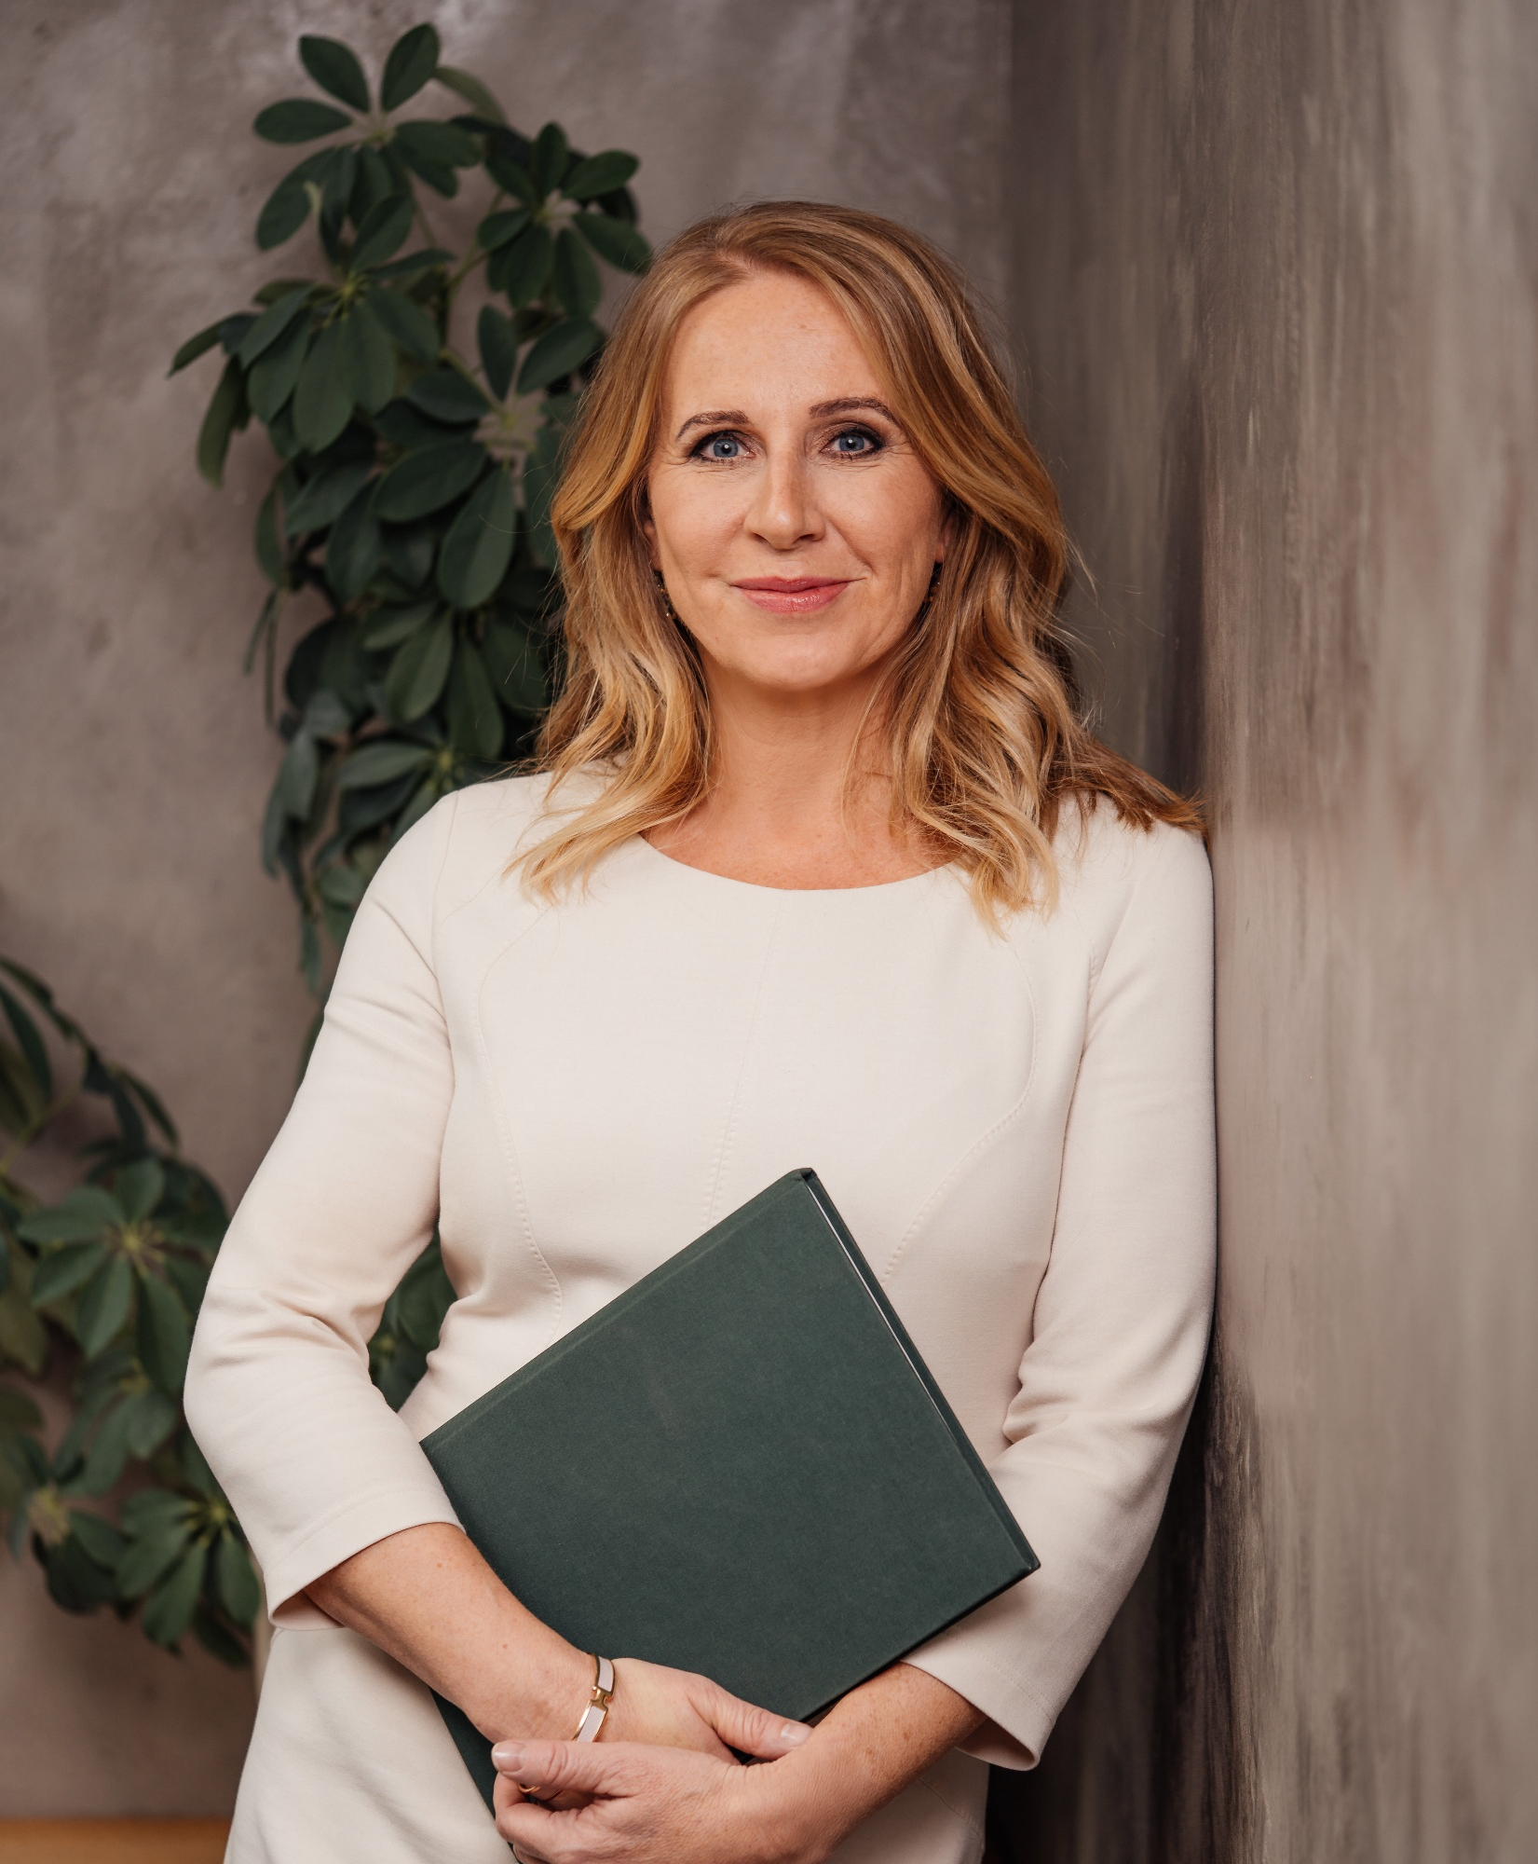
JUDr. Margareta Sovova
Managing Partner International
Margareta is an internationally recognized legal expert with more than two decades of experience in mergers and acquisitions, real estate, banking & finance, and capital markets law. As Managing Partner at LYNX International, plays a key role in driving both the firm’s local legal strategy and cross-border business development initiatives.
Margareta pairs her legal acumen with active involvement in international professional networks. She serves as Chair of the Diversity and Inclusion Council of the International Bar Association (IBA) and as a board member of the Slovak-German Chamber of Commerce (AHK). Her strategic contributions to these prestigious organizations reinforce her reputation as a global legal role model.
M + 421 903 792 575
margareta.sovova@lynx.legal
• • • • • • CONTACT

Slide 27

Talk to us.
We‘re prepared.
JUDR. MARGARETA SOVOVA • MANAGING PARTNER INTERNATIONAL
M +421 903 792 575 • T +421 2 57 88 00 88 • MARGARETA.SOVOVA@LYNX.LEGAL
• • • • • • CONTACT

