Slide 1


Proposal for
Legal Services
Strategic Counsel for Companies that Move Fast
Prepared for: [Client Name]
JUDr. Margareta Sovova • Rechtsanwältin • Managing Partner International
INTRO • • • • • • • • • •

Slide 2

Who we are
LYNX is an international business law firm committed to helping companies make better decisions, reduce risk, and accelerate progress. We don’t position ourselves as external advisors, but work side‑by‑side with your team – close, proactive, and deeply invested in your success.
Operating across all major Central and Eastern European markets, we deliver consistent, commercially-focused guidance that keeps your strategy moving forward – across borders and beyond expectations.
POLAND • SLOVAKIA • ROMANIA
LATVIA • CZECH REPUBLIC • ESTONIA
HUNGARY • LITHUANIA • BULGARIA
• FIRM • • • • • • • • •

Slide 3

13
22
25+
Offices across CEE
Working languages
Years of experience
60+
200+
Partners
Lawyers
• FIRM • • • • • • • • •

Slide 4
We don’t just advise
– we commit.
• • VALUES • • • • • • • •

Slide 5

Why
What
How
We fight to unlock the
maximum potential for our
clients, turning legal
challenges into strategic
advantages.
We deliver outstanding legal services to global enterprises and high-performing mid-sized companies.
Not only to protect their rights, but to help them move ahead in their markets.
With personal dedication, fast response times, and a tightly connected team that thinks and acts like entrepreneurs.
• • VALUES • • • • • • • •

Slide 6

By your side
Acting like stakeholders
We work as if we were part of your
organisation: alert, focused on your goals,
creating tailored solutions rather than standard templates.
We understand the impact legal decisions have on your business.
We advise with the same clarity, pragmatism, and ownership we would expect as business owners ourselves.
First responders
Giving you gold
You receive immediate, proactive engagement.
We react quickly, raise critical issues early, and keep your matter moving without delay.
Our work is an investment in tangible value:
better negotiation outcomes, reduced risk, stronger structures, and early dispute resolution.
• • VALUES • • • • • • • •

Slide 7

We Act Like Stakeholders.
• • • OFFICE • • • • • • •

Slide 8

Hungary
With a team of 20+ lawyers, LYNX’s Budapest office serves the legal needs of businesses with a commercial commitment in Hungary since 2003.
Co-managed by two Hungarian and two German partners, we advise international and domestic clients of all industry sectors, leveraging our diverse cultural insights and expertise to deliver comprehensive legal solutions.
BNT ÜGYVÉDI IRODA
STEFÁNIA ÚT 101- 103,
1143 BUDAPEST
T +361 413 3400
INFO.HU@BNT.EU
• • • OFFICE • • • • • • •

Slide 9

Hungary
LYNX’s Budapest office is consistently recognized by leading international directories for responsiveness, legal quality, and the ability to handle complex multi-jurisdictional work.
Legal 500 EMEA
Chambers Europe
Sector
Sector
Sector
Sector
Sector
Sector
IFLR1000 EMEA
[…]
Sector
Sector
Sector
Sector
Sector
Sector
• • • OFFICE • • • • • • •

Slide 10
Clarity Creates Advantage.
• • • • AREAS • • • • • •

Slide 11

Core
Practice Areas
Corporate and M&A
Insolvency and Restructuring
Strategic transactions, corporate
structuring & complex cross-border
deals.
Stabilizing companies, protecting
stakeholders, enabling viable
continuation.
Real Estate and Construction
Dispute Resolution
Legal support for asset deals,
development projects & financing.
Litigation & arbitration, with focus on
efficiency and strategic clarity.
Employment
IP, Technology and Data
Modern labour law solutions for
scaling organisations.
360° protection for digital business
models and intellectual property.
• • • • AREAS • • • • • •

Slide 12
Our expertise
Agribusiness
Environment
Banking and Finance
Infrastructure
Compliance
Insolvency and Restructuring
Competition and Antitrust
IP, Technology and Data
Corporate and M&A
Life Sciences and Pharma
Defense
Public Procurement
Dispute Resolution
Real Estate and Construction
Employment
Sourcing, Commercial and Trade
Energy
• • • • AREAS • • • • • •

Slide 13
Energy
We advise across modern energy markets – from conventional sources to renewables like wind, solar, biomass, and hydro, as well as emerging technologies – where speed and precision determine success. From securing grid access and drafting PPAs to closing domestic and cross-border M&As, we position your projects to capture opportunities the moment they emerge.
We manage licensing, transactions, and project development for power and storage assets, aligning legal, technical, and financial considerations as regional markets adapt to EU policies. By integrating rigorous regulatory compliance, we ensure the long-term operability and investment certainty your projects demand.
From first-time developers to global energy players, we deliver the same clarity: practical advice grounded in how CEE markets actually work. We have closed major sector deals and managed the routine complexities that keep businesses running daily. Our lawyers understand energy economics as deeply as energy law, so every answer accounts for commercial reality.
• • • • AREAS • • • • • •

Slide 14

Speed.
Strength.
Strategy.
• • • • • HIGHLIGHTS • • • • •

Slide 15
Selected Work Highlights
Cross-Border Acquisition –
Automotive
€110M multi-jurisdictional transaction including full due diligence, SPA drafting, and regulatory coordination.
Restructuring – Technology Company
Rapid restructuring plan within six weeks, safeguarding business continuity and minimising liability.
Ligitation – Energy Sector
Successful early settlement of an €18M contractual dispute through targeted negotiation strategy.
• • • • • HIGHLIGHTS • • • • •

Slide 16
Cross-Border Acquisition – Automotive
Cross-Border Acquisition – Automotive
€110M multi-jurisdictional transaction including full due diligence, SPA drafting, and regulatory coordination.
€110M multi-jurisdictional transaction including full due diligence, SPA drafting, and regulatory coordination.
Restructuring – Technology Company
Restructuring – Technology Company
Rapid restructuring plan within six weeks, safeguarding business continuity and minimising liability.
Rapid restructuring plan within six weeks, safeguarding business continuity and minimising liability.
Ligitation – Energy Sector
Ligitation – Energy Sector
Successful early settlement of an €18M contractual dispute through targeted negotiation strategy.
Successful early settlement of an €18M contractual dispute through targeted negotiation strategy.
• • • • • HIGHLIGHTS • • • • •

Slide 17
Legal Work.
Commercial
Impact.
• • • • • • CHALLENGE • • • •

Slide 18
Your Challenge
International projects involve legal complexity, tight deadlines, and high financial stakes.
Typical challenges include:
Varying legal requirements across jurisdictions
Risk visibility & prioritisation
Need for fast, coordinated execution
Strategic negotiation positioning
LYNX helps you navigate these challenges with precision and speed.
• • • • • • CHALLENGE • • • •

Slide 19
Our Solution
LYNX provides a cross-border
legal team that:
Your benefits:
Thinks strategically
Clear decisions
Implements pragmatically
Reliable timelines
Reacts quickly
Coordinated execution
Delivers measurable results
Full ownership throughout the process
• • • • • • CHALLENGE • • • •

Slide 20
Project Approach
Timeline
Phase 1:
Kick-Off & Target Definition
Phase 2:
Legal Mapping
Phase 3:
Document Review & Drafting
Alignment on goals, priorities, constraints.
Jurisdiction analysis & identification of key risks.
Efficient, focused, business-oriented.
Phase 4:
Negotation & Structuring
Phase 5:
Implementation
Phase 6:
Closing & Handover
Strategic, assertive, and solution-driven.
Coordinated execution across all jurisdictions.
Final documentation, risk notes, next steps.
• • • • • • • SCOPE • • •

Slide 21
Scope of Work
Task 1 – Establishment of a New Company
Includes drafting all required documents (MoA, declarations), filings, business licences, registration with Companies Registry, and coordination with authorities.
Task 2 – Seat Administration
Managing the electronic mailbox and administrative obligations.
Task 3 – Deal Structure & Fee Caps
Based on preliminary information, we outline the required legal steps for this transaction and define a capped fee model.
Task 4 – Due Dilligence
Full legal due diligence including one round of Q&A, provided documents are delivered in digital form.
• • • • • • • SCOPE • • •

Slide 22
Scope
of Work
Establishment of a New Company
Includes drafting all required documents (MoA, declarations), filings, business licences, registration with Companies Registry, and coordinatiotions), filings, business licences, registration with Companies Registry, and coordination with authorities. Includes drafting all required documents (MoA, declarations), filings, business licences, registration with Companies Registry, and coordination with authorities.
Includes drafting all required documents (MoA, declarations), filings, business licences, registration with Companies Registry, and coordination with authorities. Includes drafting all required documents (MoA, declarations), filings, business licences, registration with Companies Registry, and coordination with authorities. Includes drafting all required documents (MoA, declarations), filings, business licences, registration with Companies Registry, and coordination with authorities. Includes drafting all required documents (MoA, declarations), filings, business licences, registration with.
Establishment of a New Company
Includes drafting all required documents (MoA, declarations), filings, business licences, registration with Companies Registry, and coordination with authorities.
Establishment of a New Company
Includes drafting all required documents (MoA, declarations), filings, business licences, registration with Companies Registry, and coordination with authorities.
• • • • • • • SCOPE • • •

Slide 23
Fee Model & Hourly Rates
Partner:
€ XXX / hour
Senior Associate:
€ XXX / hour
Associate:
€ XXX / hour
Blended Travel Rate:
€ XXX / hour
Office Costs:
5% flat charge
Translations would be charged for according to the half above hourly rate. Travel time required in connection with the project is chargeable time, which will be charged on a blended (flat) rate of € ____ per hour. LYNX sets office costs (postage, telephone, copies, digital signatures and digital time stamps) at a lump sum in the amount of 5% of fees charged.
The amounts quoted for services do not include VAT.
Liability is limited to €______ in single cases for deliberate acts and gross negligence. Limitation of liability was taken into consideration when setting the fees in this Agreement. Higher limits of liability may be set in writing in individual cases with adjustment of fees accordingly.
Advance payment
With respect to the estimated time needed for your case, we will invoice you an advance payment in the amount of € _____ which will be due within 3 days from the signing of our Fee Agreement.
• • • • • • • • FEE • •

Slide 24


Fee Model
& Hourly Rates
Partner:
€ XXX / hour
Senior Associate:
€ XXX / hour
Associate:
€ XXX / hour
Blended Travel Rate:
€ XXX / hour
Office Costs:
5% flat charge
Translations would be charged for according to the half above hourly rate. Travel time required in connection with the project is chargeable time, which will be charged on a blended (flat) rate of € ____ per hour. LYNX sets office costs (postage, telephone, copies, digital signatures and digital time stamps) at a lump sum in the amount of 5% of fees charged.
The amounts quoted for services do not include VAT.
Liability is limited to €______ in single cases for deliberate acts and gross negligence. Limitation of liability was taken into consideration when setting the fees in this Agreement. Higher limits of liability may be set in writing in individual cases with adjustment of fees accordingly.
Advance payment
With respect to the estimated time needed for your case, we will invoice you an advance payment in the amount of € _____ which will be due within 3 days from the signing of our Fee Agreement.
• • • • • • • • FEE • •

Slide 25
Agile.
Dedicated.
Hands-on.
• • • • • • • • • TEAM •

Slide 26
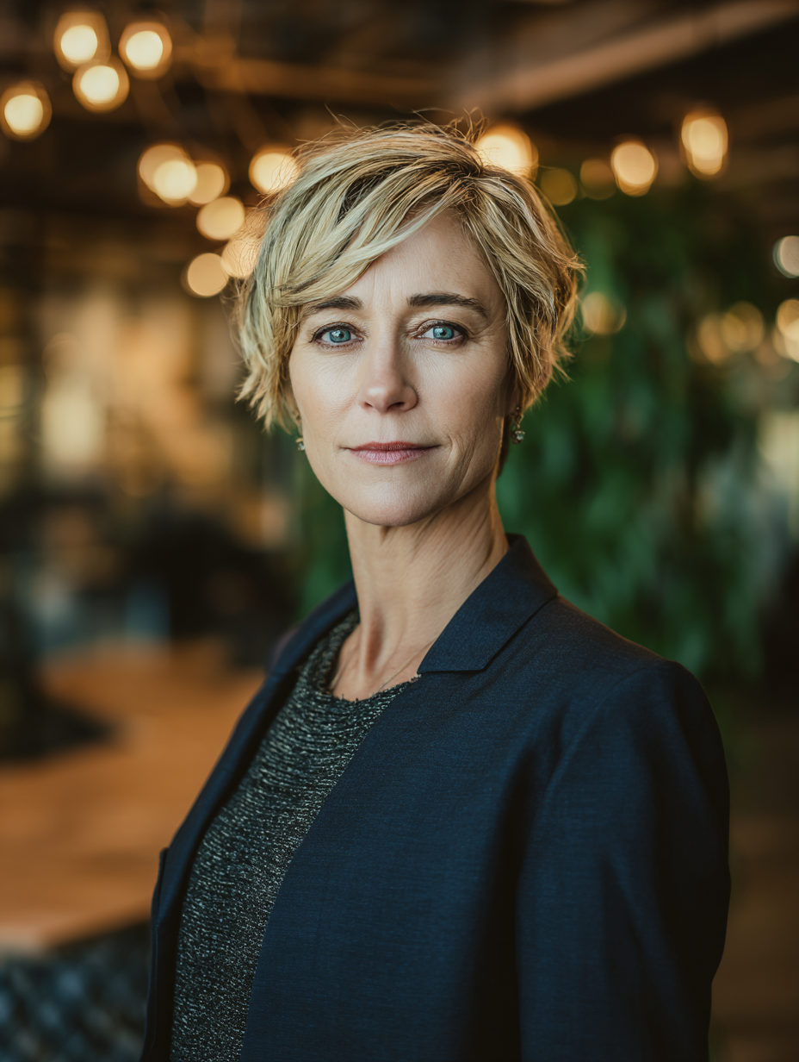
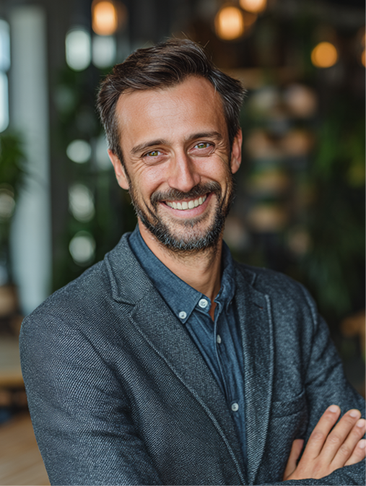
Our Key Experts
Our 200+ lawyers across 13 offices ensure seamless support in all major CEE jurisdictions. Depending on the scope, these specialists may join your project:
Real Estate and Construction
Corporate and M&A
Max Mustermann
Partner
Max Mustermann
Partner
• • • • • • • • • TEAM •

Slide 27
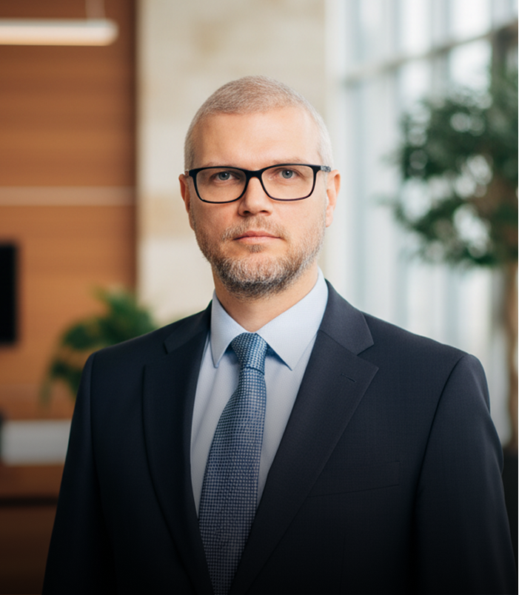
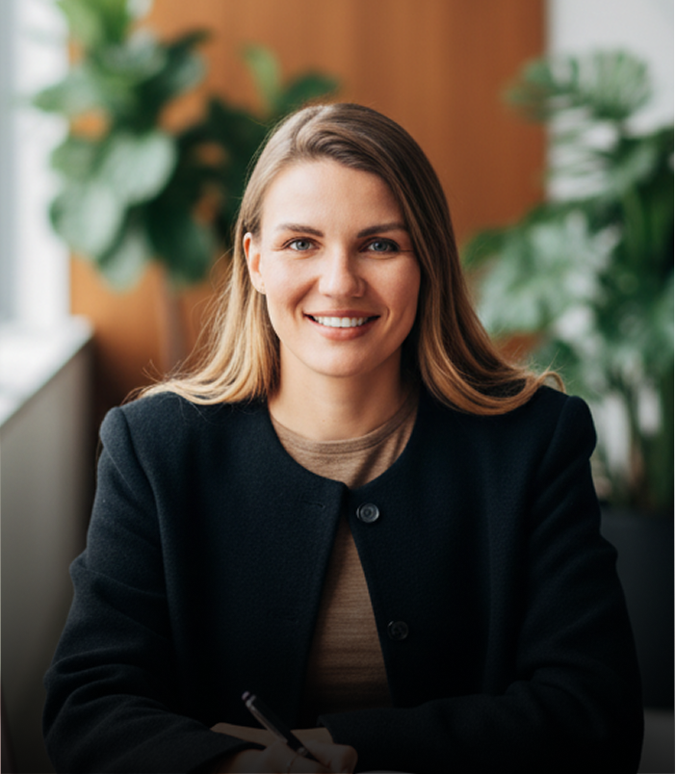
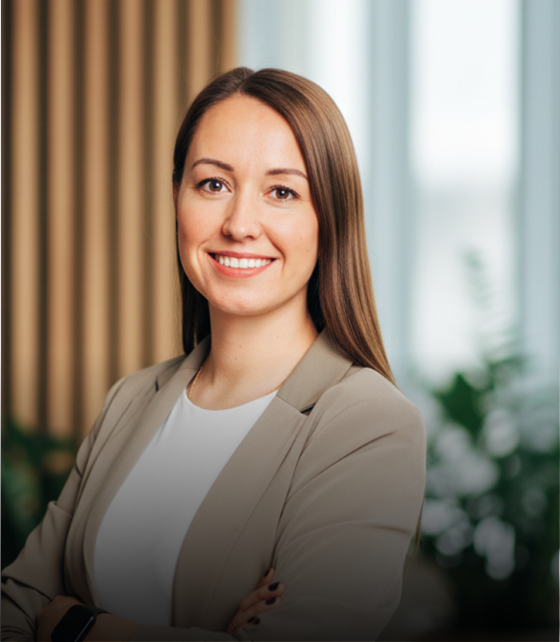
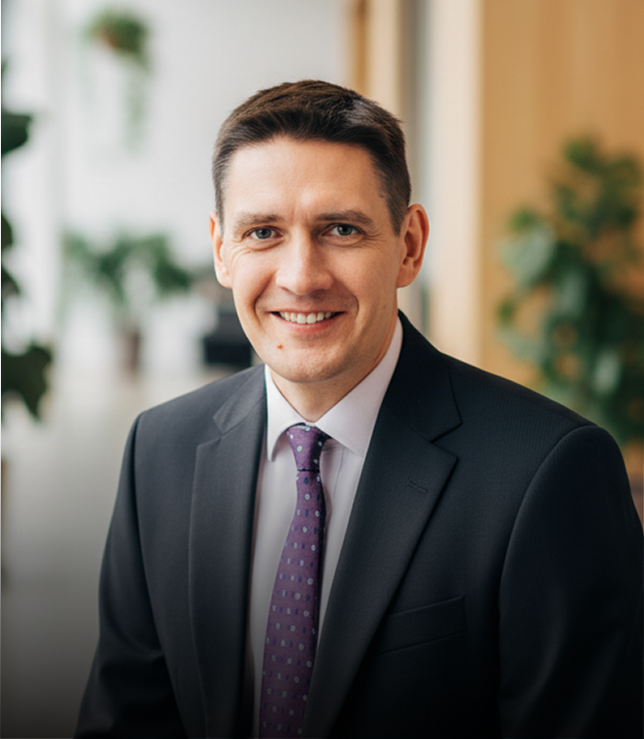
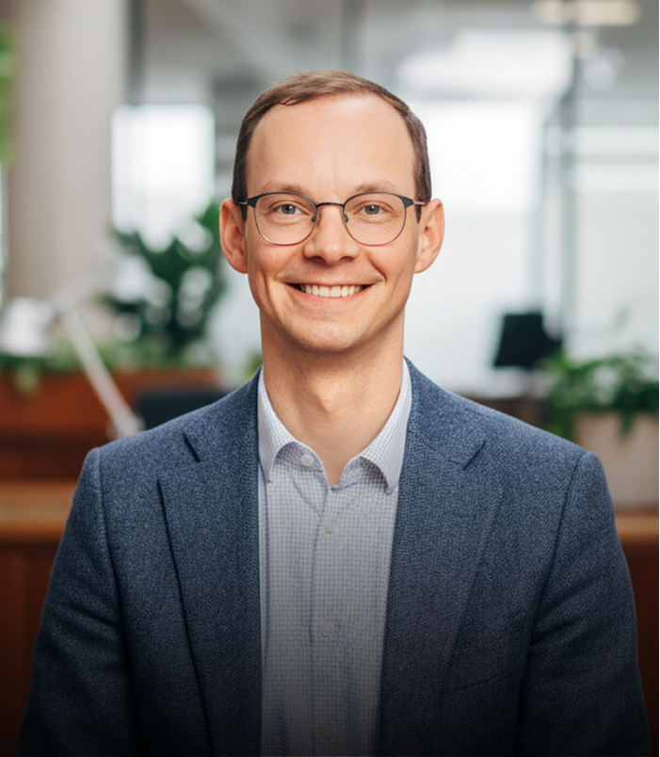
Our Key
Experts
Our 200+ lawyers across 13 offices ensure seamless support in all major CEE jurisdictions.
Depending on the scope, these specialists may join your project:
Real Estate and Construction
Real Estate and Construction
Real Estate and Construction
Real Estate and Construction
Real Estate and Construction
Max Mustermann
Partner
Max Mustermann
Partner
Max Mustermann
Partner
Max Mustermann
Partner
Max Mustermann
Partner
• • • • • • • • • TEAM •

Slide 28
JUDr. Margareta Sovova
Rechtsanwältin
Partner
JUDr. Margareta Sovova has been practicing in the Slovak Republic since 1999 and as of 2003 she has been registered with both the German and Slovak Bar Associations. Before establishing the bnt Bratislava office in 2004, Ms. Sovova managed the legal advice division of a German consulting firm in the Slovak capital.
Her practice areas are M&A, real estate, banking and finance. As managing partner she coordinates the business development and marketing activities of bnt.
Furthermore, Margareta chairs the Legal Committee and is a member of the Logistics Committee of the German-Slovak Chamber of Industry and Commerce in Slovakia. Ms. Sovova is Chair of the Diversity & Inclusion Group of European Regional Forum of the International Bar Association.
M + 421 903 792 575
margareta.sovova@bnt.eu
• • • • • • • • • TEAM •

Slide 29
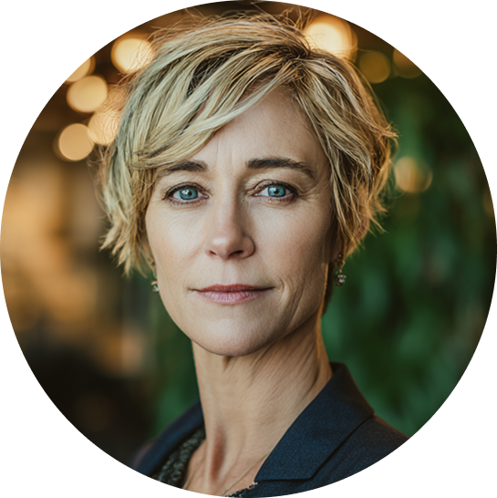
Talk to us.
We‘re prepared.
JUDR. MARGARETA SOVOVA • RECHTSANWÄLTIN • MANAGING PARTNER INTERNATIONAL
M +421 903 792 575 • T +421 2 57 88 00 88 • MARGARETA.SOVOVA@LYNX.LEGAL
• • • • • • • • • CONTACT

